Slide 1
Memristor-based Applications
Ahmed Magdy Hosney
Muhammad Mustafa Mahmud

Slide 2
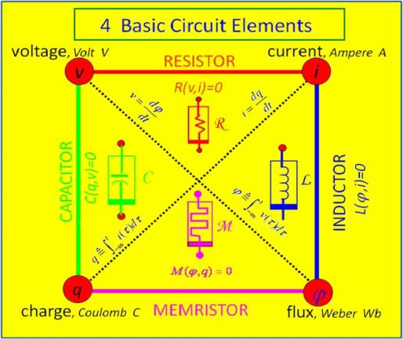
Introduction
Chua’s missing element.

Slide 3
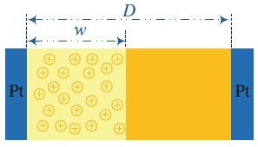
Introduction
HP Memristor.

Slide 4
Memristor applications
Memristor-based oscillators.
Programmable analog circuits.
Neuromorphic circuits.
Chaotic systems.

Slide 5
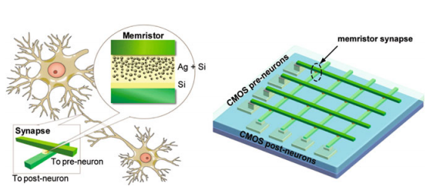
Neuromorphic circuits

Slide 6
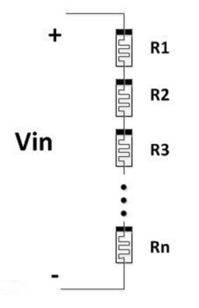
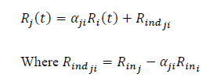
Memristor networks analysis
N series network.

Slide 7
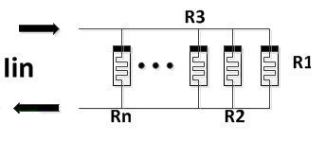
Memristor networks analysis
N parallel network.

Slide 8
Voltage controlled oscillator
Memristor-based VCO
V_{p}
+
-
V_{o1}
VGA
+
-
R_{a}
V_{n}
V_{o2}
R_{b}

Slide 9
Voltage controlled oscillator
Output frequency,
Operation conditions,

Slide 10
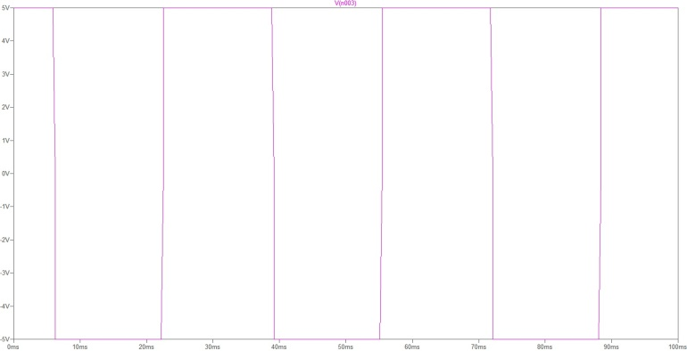
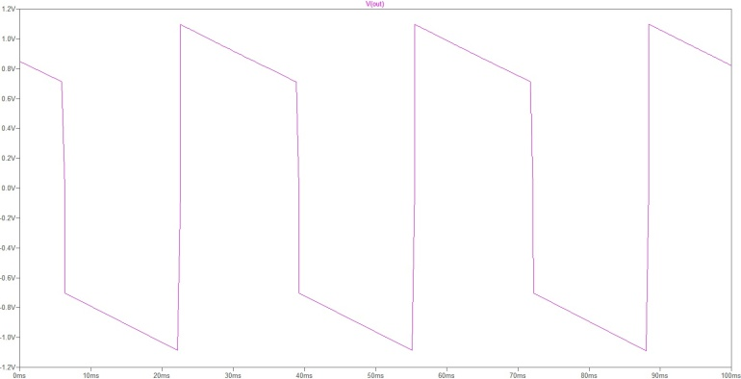
Voltage controlled oscillator
SPICE simulations

Slide 11
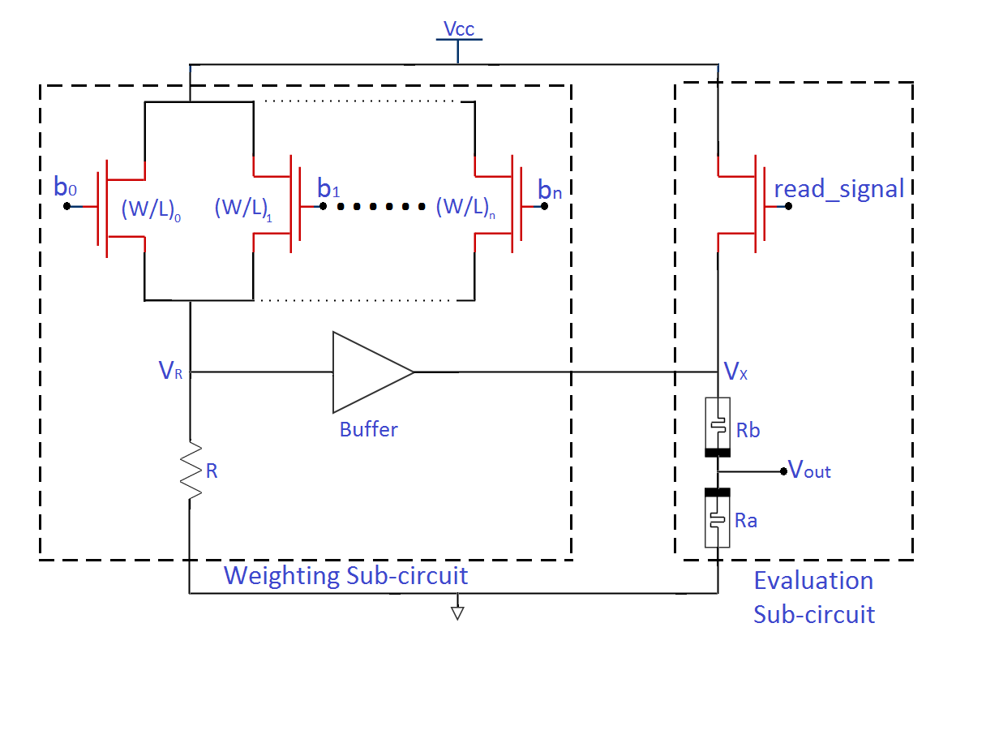
D/A converters
Unbalanced sizing D/A converter

Slide 12
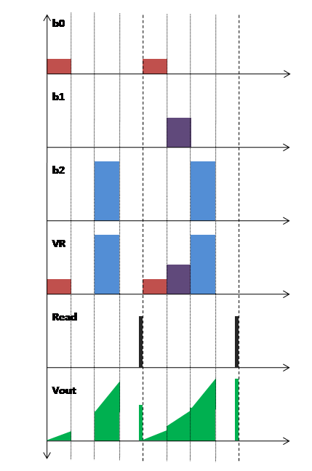
D/A converters
Sizing ratio
3-bit example.

Slide 13
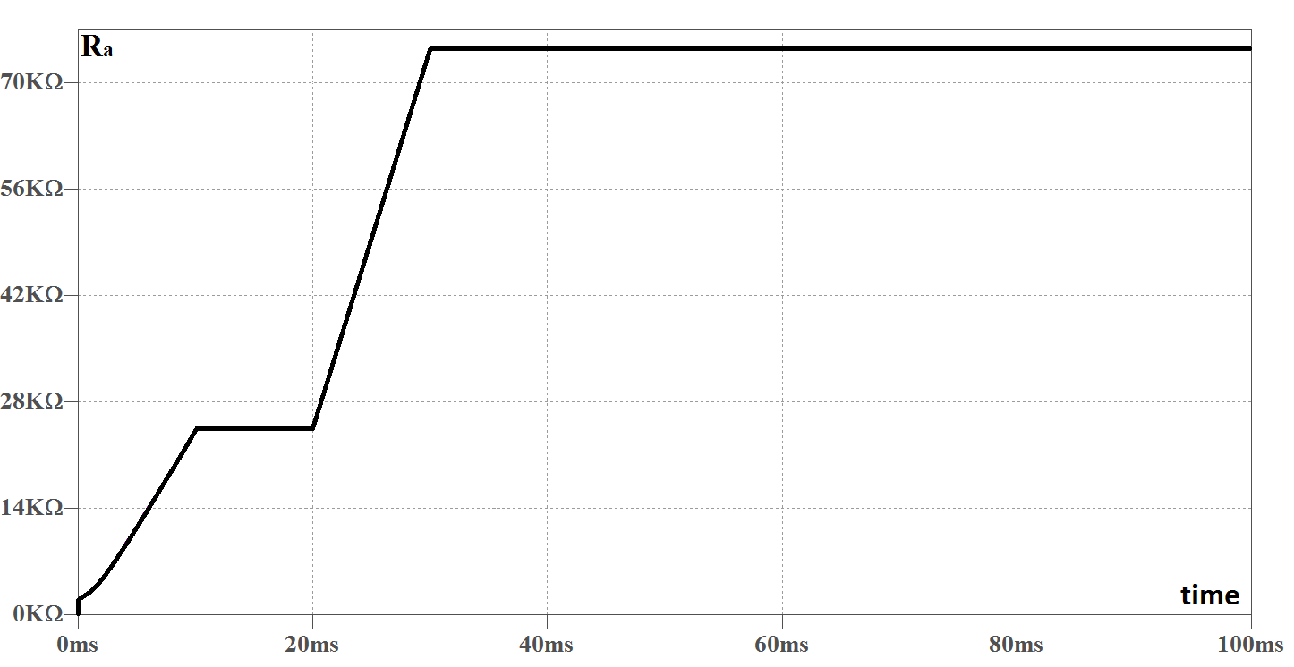
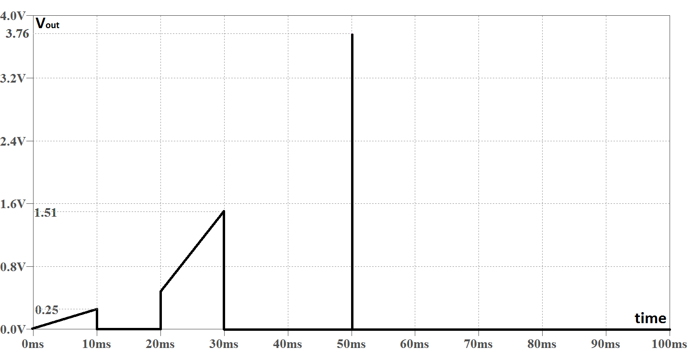
D/A converters
Spice simulations

Slide 14
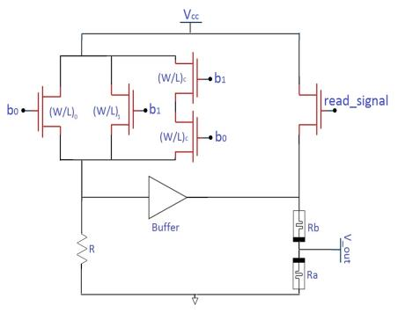
D/A converters
Compensated circuit
Sizing

Slide 15
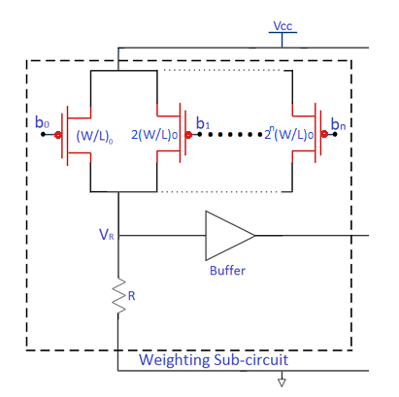
D/A converters
Balanced-sizing circuit
Limitation on sizing,

Slide 16
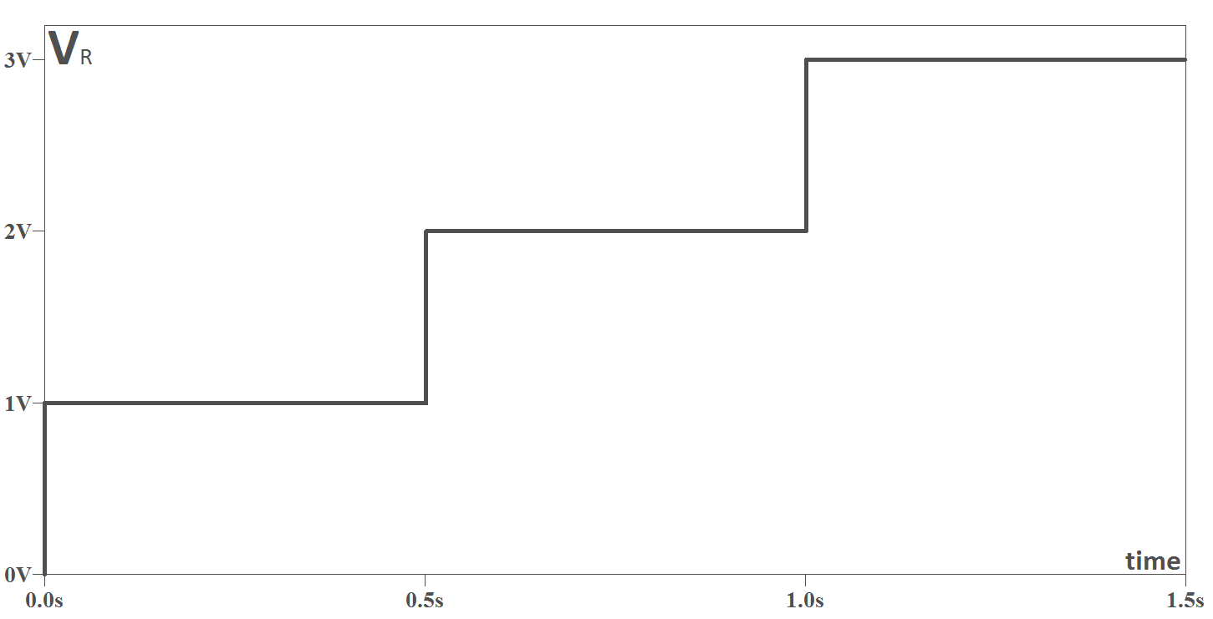
D/A converters
SPICE simulations.

Slide 17
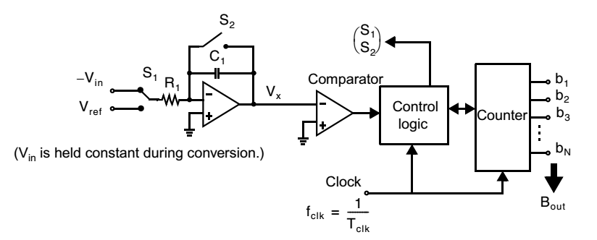
A/D converters
Integrating A/D converter.

Slide 18
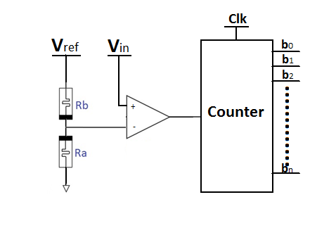
A/D converters
Memristor-based A/D converter.
Time relation,

Slide 19
A/D converters
4-bit example
3.4375 – 3.75 | 11 | 1011
3.75 – 4.0625 | 12 | 1100
4.0625 – 4.375 | 13 | 1101
4.375 – 4.6875 | 14 | 1110
4.6875 – 5 | 15 | 1111

Slide 20
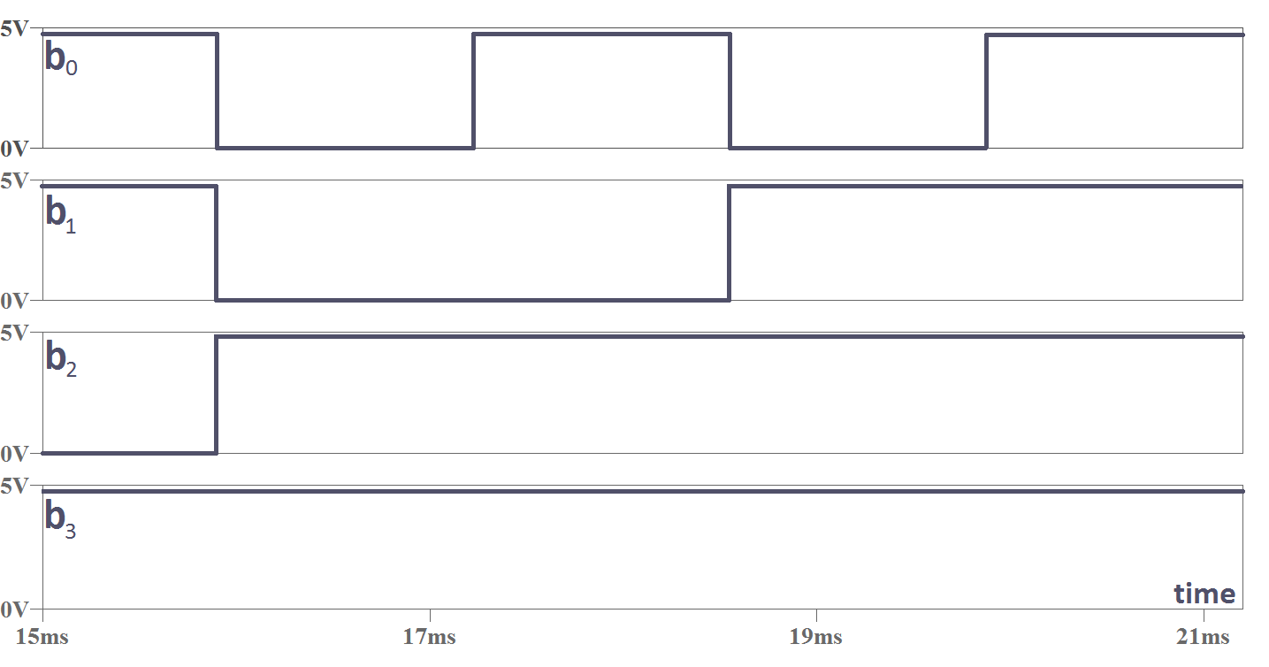
A/D converters
SPICE simulations.
4.85 volts.

Slide 21
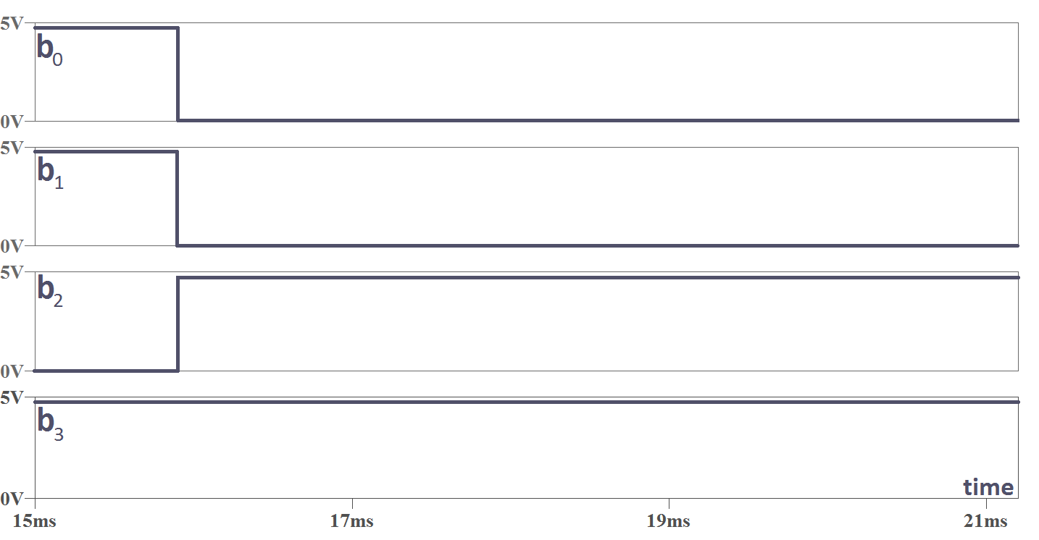
A/D converters
SPICE simulations.
3.85 volts.

Slide 22
Memristor-based PWM
Input to memristor version.
Needs resetting phase.

Slide 23
Memristor-based PWM
Pre-modulation circuit.

Slide 24
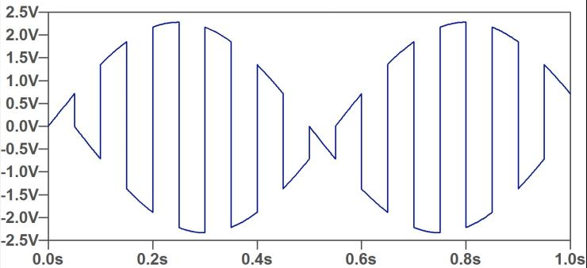
Memristor-based PWM
Pre-modulation circuit.

Slide 25
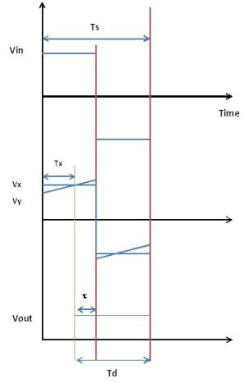
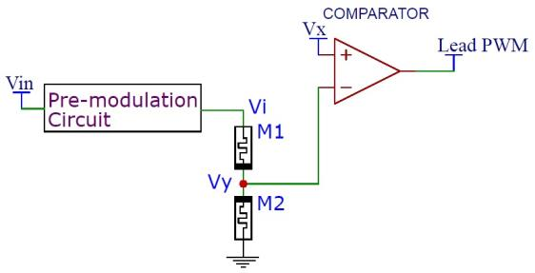
Memristor-based PWM
Lead edge PWM.

Slide 26
Memristor-based PWM
Lead edge PWM.
Operation conditions.

Slide 27
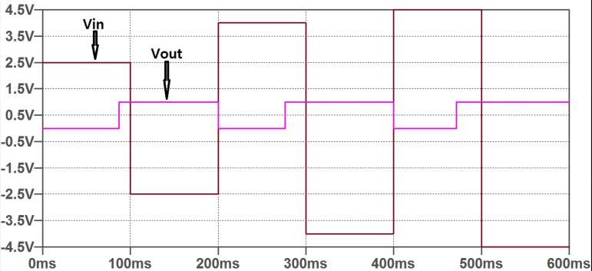
Memristor-based PWM
Lead edge PWM.

Slide 28
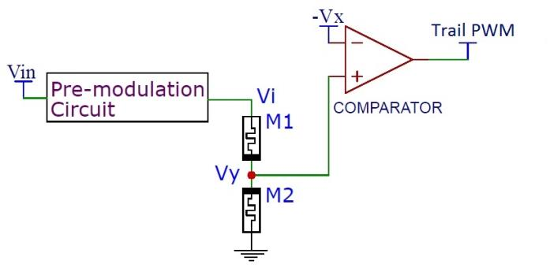
Memristor-based PWM
Tail edge PWM.

Slide 29
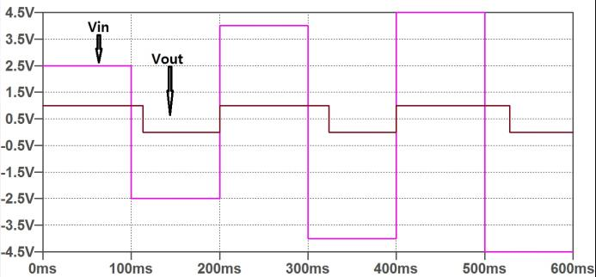
Memristor-based PWM
Tail edge PWM.

Slide 30
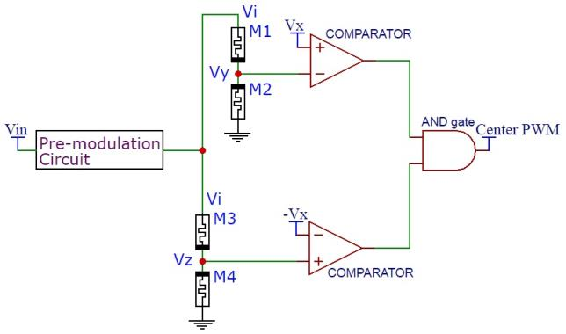
Memristor-based PWM
Center PWM Design #1.

Slide 31
Memristor-based PWM
Center PWM Design #1.

Slide 32
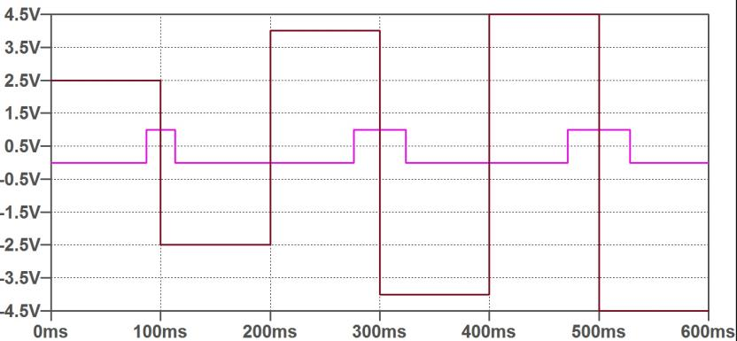
Memristor-based PWM
Center PWM Design #1.

Slide 33
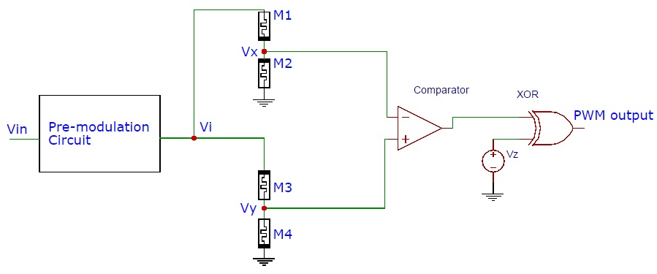
Memristor-based PWM
Center PWM Design #2.

Slide 34
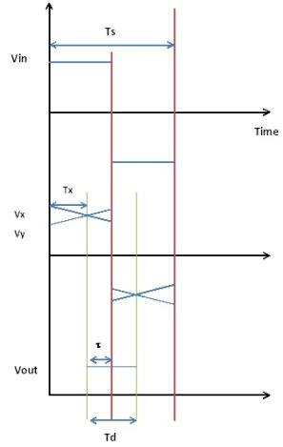
Memristor-based PWM
Center PWM Design #2.

Slide 35
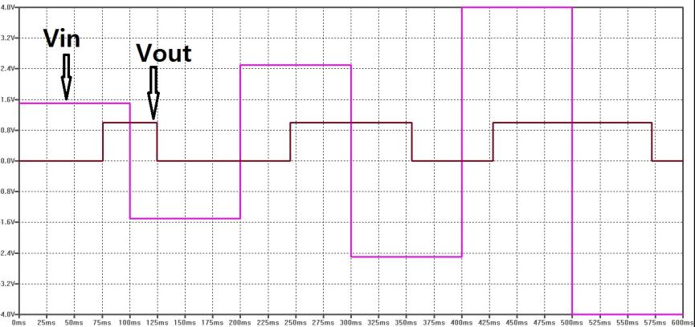
Memristor-based PWM
Center PWM Design #2.

Slide 36
Questions!

Slide 37
THANKS

