Slide 1
Patient assistant robot
Superviserd by:
Dr : Ahmed mostafa
Presented by :
1- Amira Ibrahim Sayed
2-Asmaa Mohamed Saad
3-Amna Ahmed Mohammed

Slide 2
Contents…
Absrtact
Tries
Hardware

Slide 3
ABSTRACT
The patient assistant robot
About robot
Future seen

Slide 4
The patient assistant robot
purpose of the experiment to help the owners of infectious diseases and to isolate them from healthy people until recovery.
Procedures : We started doing the robot , which is helping patients with some tasks that are difficult for them to do ,, and also bring them food and medicine at specific times .
Data : This robot goes to every patient room to provide him with food and water and needed medication. It also measures the patient's temperature , if necessary, and give him medicine to reduce the temperature if the temperature is higher than usual. Also doing other tests for the patient .

Slide 5
About robot
manufacture our own robot, which consist of base which carry model of robot with a tool to lift and carry things to their delivery to the patient.
robot movement is performed using dc motors and stepper motors (DC Motors : Fast, continuous rotation motors – give high RPM ,,a stepper motor has positional control ) .
control this robot by computer using GUI which send orders from computer to robot through wireless communication.(we use this method for easy control over awide distance )
use ic type mega (atmega16 ) in programming (as we want to learn writing codes by ourselves)

Slide 6
Future seen
In the future, all hospital services will depend on the robot, which will make business owners interested in robots. They will pay attention to the development of the robot to get to the most efficient and least expensive robot .
We aspire to develop the robot to be able to work the necessary tests for the patient . On the basis of these tests gives him the right medicine . The robot also follow up the patient on a regular basis until recovery.
set up a hospital for people suffering from infectious diseases , which depends entirely on robots in all services pertaining to patients to provide them with the necessary assistance during the treatment period until recovery

Slide 7
Hadware : 1- wheel 2- gear 3- left 4- stand 5-stepper motor 6-stepper motor driver

Slide 8
7- DMOS Microstepping Driver with Translator and Overcurrent Protection
8- DC motor
9- L298 Dual Motor Driver Module 2A
10-ultrasonic
11-LM35 (Temperature sensor )
12-Wireless Module Serial UART (200M Range-433 Mhz)
13-USB-XBEE Adapter

Slide 9
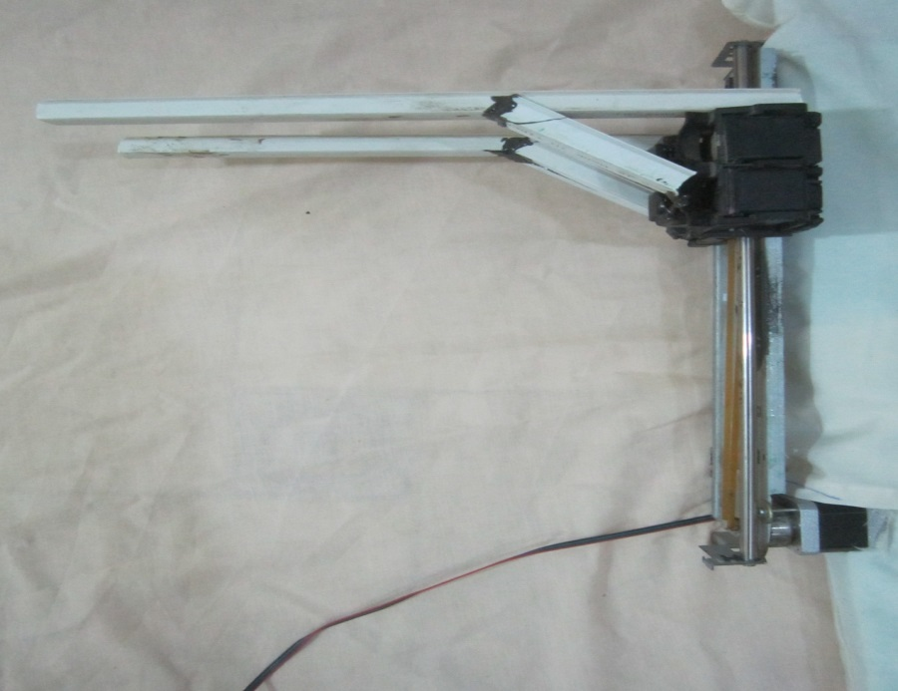
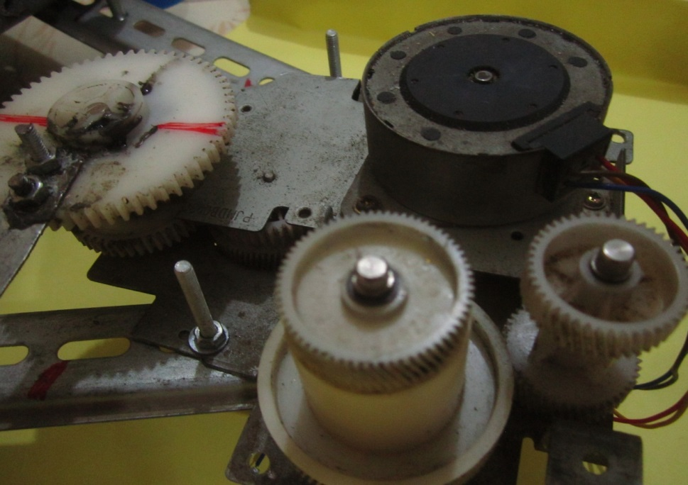
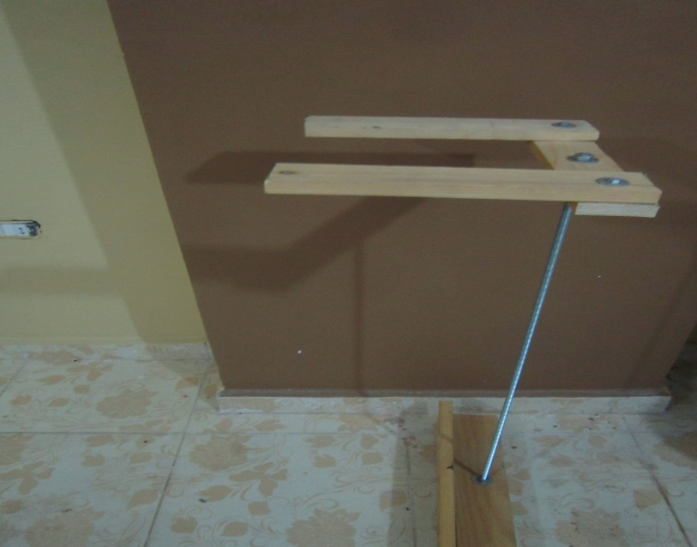

Slide 10
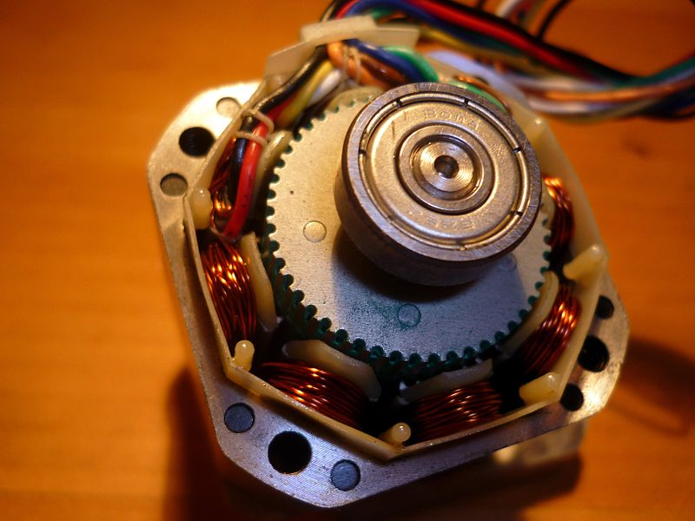
Stepper motor
A stepper motor or step motor or stepping motor is a brushless DC electric motor that divides a full rotation into a number of equal steps. The motor's position can then be commanded to move and hold at one of these steps without any feedback sensor (an open-loop controller), as long as the motor is carefully sized to the application in respect to torque and speed.
Switched reluctance motors are very large stepping motors with a reduced pole count, and generally are closed-loop commutated.

Slide 11
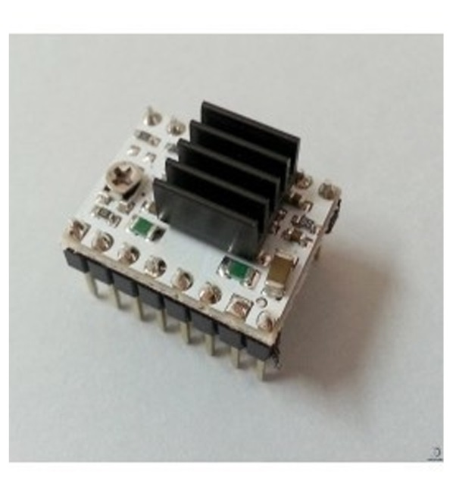
Stepper motor driver circuits
Features
Five different step resolutions: full-step, half-step, quarter-step, eighth-step, and sixteenth-step
Adjustable current control lets you set the maximum current output with a potentiometer.
Over-temperature thermal shutdown, under-voltage lockout, and crossover-current protection
Short-to-ground and shorted-load protection

Slide 12
DMOS Microstepping Driver with Translator and Overcurrent Protection
Features and Benefits
Low R DS(ON) outputs
Automatic current decay mode detection/selection
▪ Mixed and Slow current decay modes
Synchronous rectification for low power dissipation
Internal UVLO
Crossover-current protection
3.3 and 5 V compatible logic supply
Thermal shutdown circuitry
Short-to-ground protection
Shorted load protection

Slide 13
DC motor
A DC motor is any of a class of electrical machines that converts direct current electrical power into mechanical power. The most common types rely on the forces produced by magnetic fields. Nearly all types of DC motors have some internal mechanism, either electromechanical or electronic, to periodically change the direction of current flow in part of the motor. Most types produce rotary motion; a linear motor directly produces force and motion in a straight line.
DC motors were the first type widely used, since they could be powered from existing direct-current lighting power distribution systems.

Slide 14
A DC motor's speed can be controlled over a wide range, using either a variable supply voltage or by changing the strength of current in its field windings. Small DC motors are used in tools, toys, and appliances. The universal motor can operate on direct current but is a lightweight motor used for portable power tools and appliances. Larger DC motors are used in propulsion of electric vehicles, elevator and hoists, or in drives for steel rolling mills. The advent of power electronics has made replacement of DC motors with AC motors possible in many applications

Slide 15
Dual channel 10Dc motor driver
1. Sign-Magnitude PWM – For sign-magnitude PWM operation, 2 control signals are used to
control the speed and direction of the motor. PWM is feed to the PWM pin to control the
speed while DIR pin is used to control the direction of the motor.
2. Locked-Antiphase PWM – For locked-antiphase PWM operation, only 1 control signal is
needed to control the speed and direction of the motor. PWM pin is connected to logic high
while the DIR pin is being feed with the PWM signal. When the PWM signal has 50% duty
cycle, the motor stops running. If the PWM has less than 50% duty cycle, the motor will turn
CW (or CCW depending on the connection). If the PWM signal has more than 50% duty
cycle, motor will turn CCW (or CW depending on the connection).

Slide 16
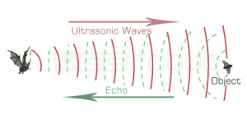
Ultrasonic
Bats are mammals like us and many of our pets. What is interesting about bats is the way they find and identify objects around them. They use a method known asecholocation. Bats use sound to sense distance; they emit high frequency sound waves (too high for humans to hear) and the echoes they get back give them information about anything obstructing their way, including the size and shape of the obstacle. This obstacle can even be an insect which could be its midnight meal. But how do the bats calculate the distance to its obstacle? They carefully calculate the time it takes for the echo to return and time of echo is proportional to the distance to the nearest object.

Slide 17
LM35 (Temperature sensor )
Operating Voltage: 4-20V
3 pins: VCC, GND, SIGNAL
SIGNAL pin changes voltage according to the temprature
LM35 is a 3 pin temperature sensor which requires a VCC and GND and in return the remaining third pin gives us an analog output. For its pin configurations refer to the Circuit Diagram below. This output is then provided to the ADCs present in AtMega 16 IC which according to a formula calculate the temperature in °C format.
The LM35 series are precision integrated-circuit temperature sensors, whose output voltage is linearly proportional to the Celsius (Centigrade) temperature. The LM35 thus has an advantage over linear temperature sensors calibrated in ° Kelvin.

Slide 18
Wireless Module Serial UART (200M Range-433 Mhz)
This wireless UART module is a new-generation multi-channel embedded wireless data transmission module. Its wireless working frequency band is 433.4-473.0 MHz, multiple channels can be set, with the stepping of 400KHz, and there are 100 channels in total. The maximum transmitting power of module is 100mW(20dBm), the receiving sensitivity is -117dBm at baud rate of 5000bps in the air, and the communication distance is 1000m in open space.
There is MCU on the module, and program is needed to utilize the module. In transparent transmission mode, the module act like normal receiving and sending serial port data,

Slide 19
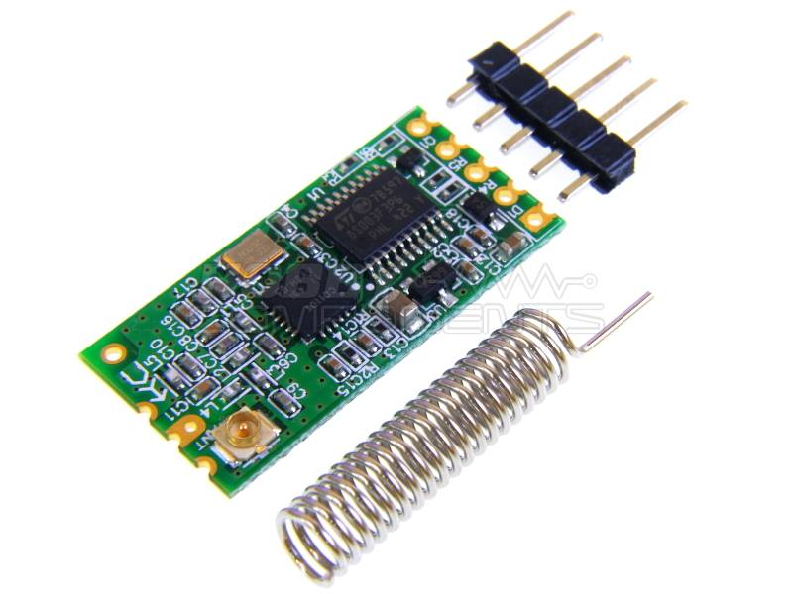
so it is convenient to use. The module adopts multiple serial port transparent transmission modes, and user could select them by AT command according to user's requirements. The average working current of three modes FU1, FU2 and FU3 in idle state is 80µa, 3.5mA an 22mA respectively, and the maximum working current is 100mA (in transmitting state).

Slide 20
AT Command mode
AT
Send this command, will return to OK characters
Example: hair AT return OK
AT + V
Module to return to version information
Example: hair AT + V to return to HC-11 _V1.9
AT + Bxxxx
The baude rate set to XXXX. This value is 0960 0192 00384 00576 2400480 00115 200. Ex 1: hair AT + B4800 return OK-4800 Example 2: hair AT + B115200 return OK-115200
AT + Cxxx
Setting wireless module. From 001 to 127 can be chosen
Example: hair AT + C058 return OK-058
AT + Axxx
Setting wireless module address. From 000 to 255 can be chosen
Example: hair AT + A123 return OK-A123

Slide 21
USB-XBEE Adapter
This module can be used as USB-BEE adaptor and at the same time it can be used as USB to UART adapter.
It is equipped with BEE socket (20pin 2.0mm). Using this converter enables you to connect any bee module such as Zigbee, Bluetooth bee or WIFI bee, to usb directly.
Therefore you might connect your PC to various wireless applications such as Arduino or Android mobile via a Bee compatible module. The USB-BEE converter is based on FT232RL The ever popular FTDI USB to UART IC.

Slide 22
Thank you!!!

